Slide 1

Git Lecture-1
www.corvit.com

Slide 2
Topics
What is Git?
Different Git Vendors.
Installing Git (Linux + Windows)
Using Git (Command line + GUI).
Configuring Git.
Cloning Repository Exercise
Essential Commands.
Basic Flow
www.corvit.com

Slide 3
Git
Git is the most famous Version Control System. Version control, also known as source control, is the practice of tracking and managing changes to software code. Version control systems are software tools that help software teams manage changes to source code over time. As development environments have accelerated, version control systems help software teams work faster and smarter. They are especially useful for DevOps teams since they help them to reduce development time and increase successful deployments.
A complete long-term change history of every file. This means every change made by many individuals over the years.
Branching and merging
Traceability
www.corvit.com
Notes:
https://www.atlassian.com/git/tutorials/what-is-version-control

Slide 4
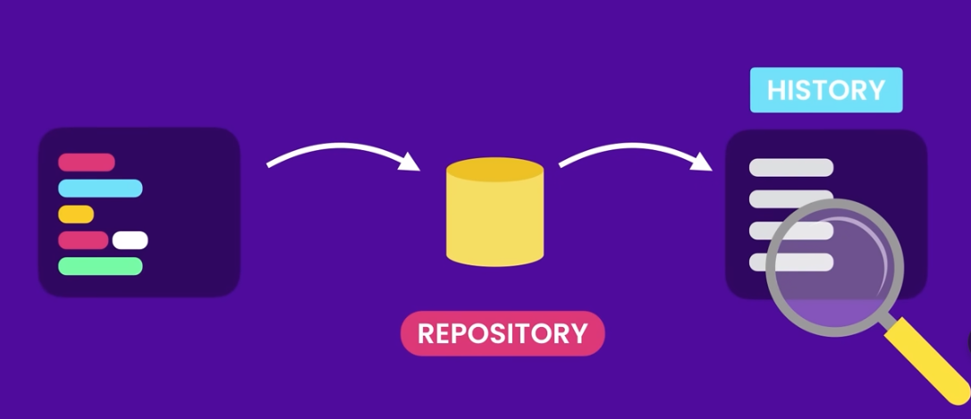
Git Repository Structure
www.corvit.com

Slide 5
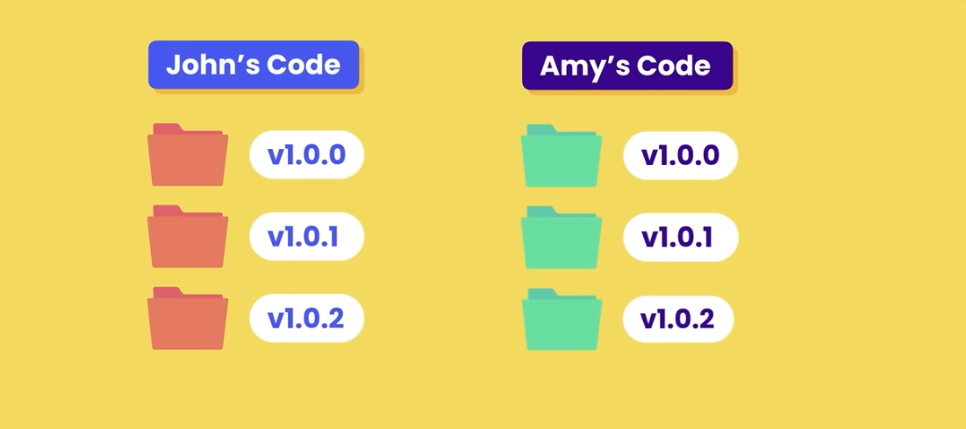
Version Control
www.corvit.com

Slide 6
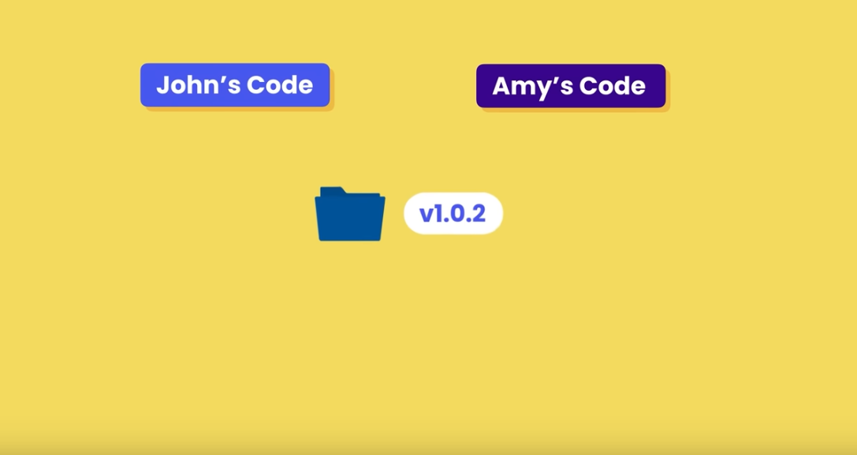
Version Control
www.corvit.com

Slide 7
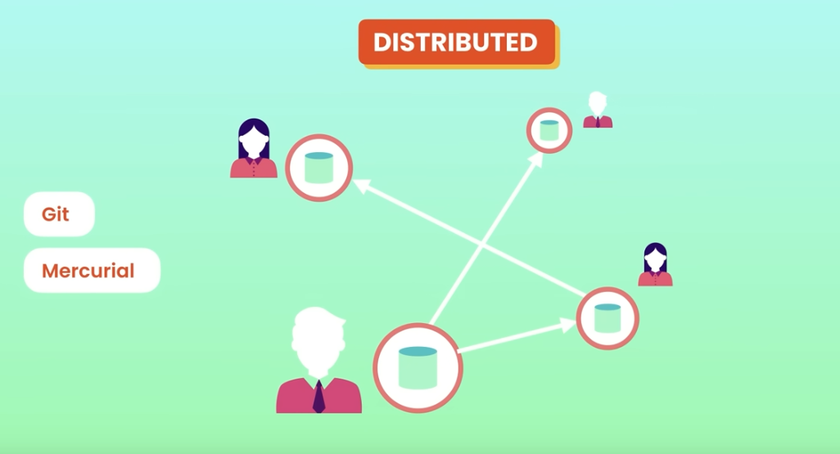
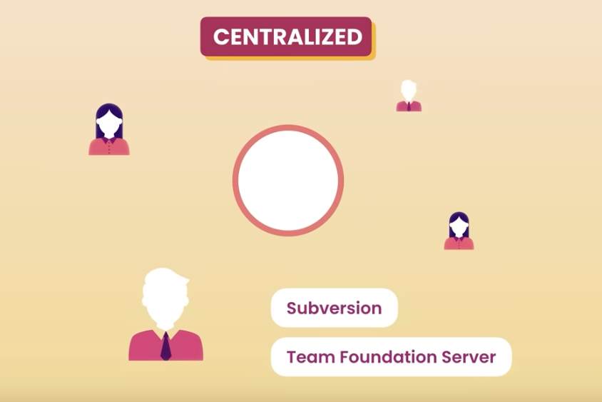
Version Control System
www.corvit.com

Slide 8
Why Git
Free
Open Source
Super Fast
Scalable
Track History
Work Together
www.corvit.com

Slide 9
Git Providers
GitHub Cloud
GitHub On premises
Bitbucket
GitLab Cloud
GitLab On premises
Azure DevOps Git
Atlassian Stash (old version of Bibucket Server)
Bitbucket Server (new version of Stash)
www.corvit.com
Notes:
https://codefresh.io/docs/docs/integrations/git-providers/

Slide 10
Using Git
Command Line (VS Code, Git Bash)
GUI (Github Desktop, Sourcetree, GitForce and etc)
www.corvit.com
Notes:
https://code.visualstudio.com/docs/sourcecontrol/overview https://blog.devart.com/best-git-gui-clients-for-windows.html

Slide 11
Installing Git
Follow the guide to install git on Linux, Windows and MacOS. https://github.com/git-guides/install-git
www.corvit.com

Slide 12
Settings
Name
Email
Default Editor
Line Ending
www.corvit.com

Slide 13
Settings
System: All Users
Global: All repositories of the Current User
Local: The current repository
www.corvit.com

Slide 14
Line Ending
Windows
MacOS / Linux
abc \r\n \r: carriage return \n: line feed
abc \n
www.corvit.com

Slide 15
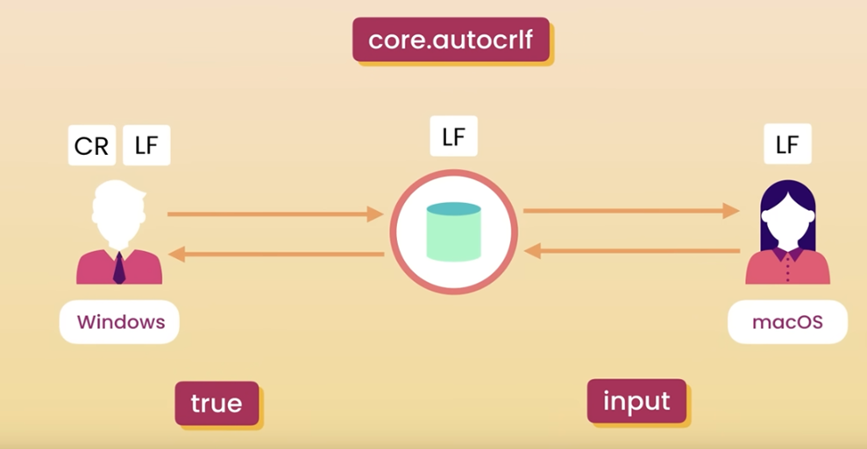
www.corvit.com

Slide 16
Git Commands
Git clone:
Git clone is a command for downloading existing source code from a remote repository (like Github, for example). In other words, Git clone basically makes an identical copy of the latest version of a project in a repository and saves it to your computer.
There are a couple of ways to download the source code, but mostly I prefer the clone with https way:
git clone <https://name-of-the-repository-link>
www.corvit.com

Slide 17
Git Commands
Git checkout:
Branches are highly important in the git world. By using branches, several developers are able to work in parallel on the same project simultaneously. This is also one of the most used Git commands. To work in a branch, first you need to switch to it. We use git checkout mostly for switching from one branch to another. We can also use it for checking out files and commits.
git checkout <name-of-your-branch> (switch to the branch)
git checkout -b <name-of-your-branch> (create a new branch and switch to it)
www.corvit.com

Slide 18
Git Commands
Git status:
The Git status command gives us all the necessary information about the current branch.
git status
We can gather information like:
Whether the current branch is up to date
Whether there is anything to commit, push or pull
Whether there are files staged, unstaged or untracked
Whether there are files created, modified or deleted
www.corvit.com

Slide 19
Git Commands
Git add:
When we create, modify or delete a file, these changes will happen in our local and won't be included in the next commit (unless we change the configurations).
We need to use the git add command to include the changes of a file(s) into our next commit.
git add <file> (to add single file)
git add . OR git add –A (To add everything at once)
www.corvit.com

Slide 20
Git Commands
Git commit:
This is maybe the most-used command of Git. Once we reach a certain point in development, we want to save our changes (maybe after a specific task or issue).
Git commit is like setting a checkpoint in the development process which you can go back to later if needed.
We also need to write a short message to explain what we have developed or changed in the source code.
git commit -m "commit message"
www.corvit.com

Slide 21
Git Commands
Git push:
After committing your changes, the next thing you want to do is send your changes to the remote server. Git push uploads your commits to the remote repository.
git push -origin <branch_name>
www.corvit.com

Slide 22
Git Commands
Git pull:
The git pull command is used to get updates from the remote repo. This command is a combination of git fetch and git merge which means that, when we use git pull, it gets the updates from remote repository (git fetch) and immediately applies the latest changes in your local (git merge).
git pull
www.corvit.com

Slide 23
Exercise
Follow the guide to clone a repo created in Azure DevOps. https://learn.microsoft.com/en-us/azure/devops/repos/git/use-ssh-keys-to-authenticate?view=azure-devops
For Github https://docs.github.com/en/repositories/creating-and-managing-repositories/cloning-a-repository
www.corvit.com

Slide 24
Basic Git Flow
Here is a basic overview of how Git works:
Create a "repository" (project) with a git hosting tool (like Bitbucket)
Copy (or clone) the repository to your local machine
Create a "branch" (version), make a change.
Add a file to your local repo and "commit" (save) the changes
"Push" your changes to your main branch
"Pull" the changes to your local machine
"Merge" your branch to the main branch
www.corvit.com

